Slide 1
File Operations with SharePointClient

Slide 2
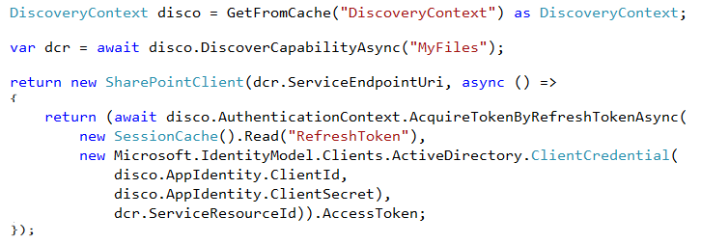
SharePointClient class
Discovery Service discovers “MyFiles” capability
Returns tenant and user-specific URL for user’s OneDrive for Business
SharePointClient.Files abstracts Files API
Notes:
The discovery service discovers the “MyFiles” capability, which will always try to access the OneDrive for Business library

Slide 3
Reading File Metadata
Read Files collection
Can also read an individual Folder
Notes:
No support for $skip and $orderby so paging is post-query

Slide 4
Uploading a new File
Use AddAsync method
Provide a file name and the file stream

Slide 5

Deleting a File
Get the target file using GetByAsync method
Delete using DeleteAsync method

Slide 6
demo
File operations with the SharePointClient

Slide 7

© 2014 Microsoft Corporation. All rights reserved. Microsoft, Windows, and other product names are or may be registered trademarks and/or trademarks in the U.S. and/or other countries.
The information herein is for informational purposes only and represents the current view of Microsoft Corporation as of the date of this presentation. Because Microsoft must respond to changing market conditions, it should not be interpreted to be a commitment on the part of Microsoft, and Microsoft cannot guarantee the accuracy of any information provided after the date of this presentation. MICROSOFT MAKES NO WARRANTIES, EXPRESS, IMPLIED OR STATUTORY, AS TO THE INFORMATION IN THIS PRESENTATION.

